Slide 1
Project Idea Presentation:
Dog Breed Identifier
Jahin Mahbub
1531552042
Group:

Slide 2
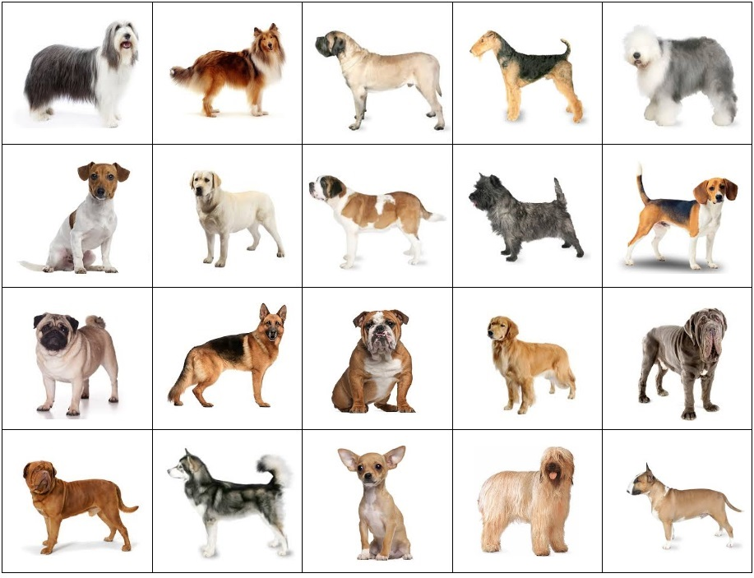
Dog Breed Identifier

Slide 3
Dog Breed Identifier
Things needed for this project:
Keras
PyTorch
Stanford Dogs Dataset. (120 Breeds, 150 images per class)
Convolutional Neural Network (CNN) used.

Slide 4
Dog Breed Identifier
Project Description :
In this project, we are provided a strictly canine subset of Images in order to practice fine-grained image categorization. How well you can we differentiate our Alsatians(German Shepherds) from your Golden Retrievers ?
Implementation:
From the thousands of images provided by our dataset, we will train them using CNN algorithm in PyTorch.

Slide 5
Dog Breed Identifier
THANK YOU!!

